Slide 1
Tips for Publishing Papers in Refereed Journals
Xinyu (Jason) Cao
Editor in Chief, Transportation Research Today
Associate Editor, Transport Policy
Associate Editor, Journal of Planning Education and Research
Co-Editor in Chief, Transportation Research Part D (2018-2025)

Slide 2
How to Review a Journal Article
What is the purpose of this article?
Why is it important to investigate or examine the subject of the article?
How are the authors carrying out the task? Are their methods and comments appropriate and adequate to the task?
What do they claim to have found out? Are the findings clearly stated?
How does this advance knowledge in the field?
By Robert M. Terry at University of Richmond
Notes:
1. What is the purpose of this article?
2. Why is it important to investigate or examine the subject of the article?
3. How are the authors carrying out the task? Are their methods and comments appropriate and adequate to the task?
4. What do they claim to have found out? Are the findings clearly stated?
5. How does this advance knowledge in the field?
Look at the organization of the article.
Can you find answers to the above questions quickly and easily?
Can you trace the logic consistently from the opening paragraphs to the conclusion?

Slide 3
Outline
Paper sections (title, keywords, abstract, introduction, literature review, conclusions)
How to frame and write a paper?
Plagiarism
Tips
Caveat: these may not be applicable to all fields and all papers.

Slide 4
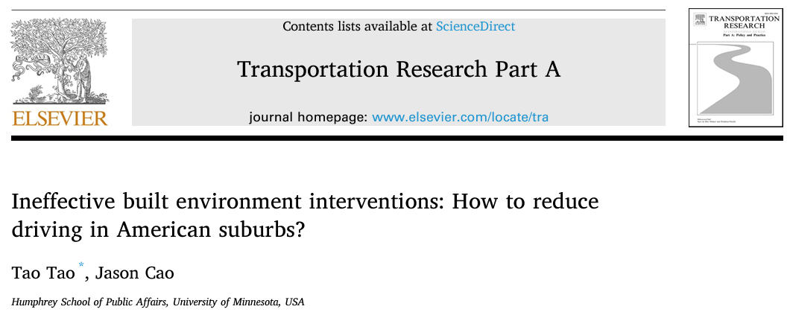
An Effective Title
Concise (more downloads)
Informative – content, keywords, jargon, acronyms
A writing hook
Notes:
http://writing.umn.edu/sws/assets/pdf/quicktips/titles.pdf
First, it predicts content. Second, it catches the reader's interest. Third, it reflects the tone or slant of the piece of writing. Fourth, it contains keywords that will make it easy to access by a computer search.
https://blog.efpsa.org/2012/09/01/how-to-write-a-good-title-for-journal-articles/

Slide 5
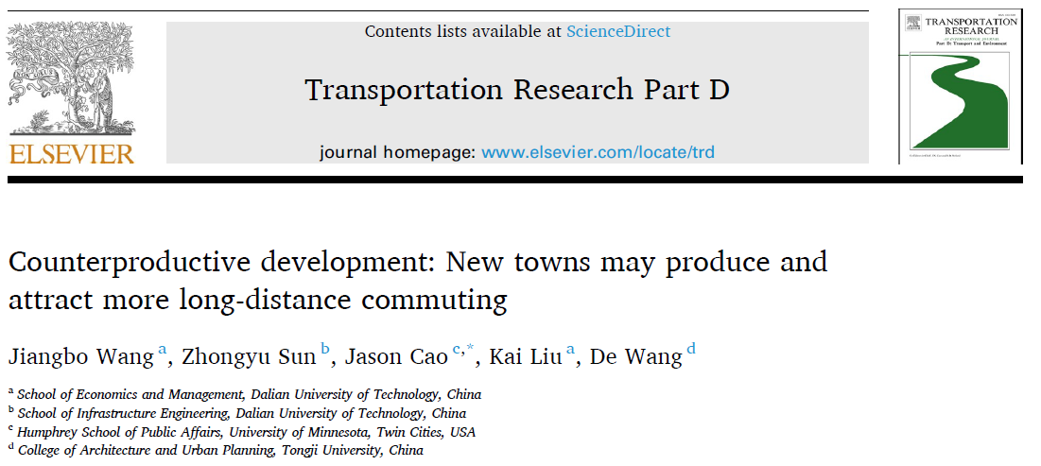
Title and keywords
What are the keywords used for?
Balance the needs between readers and (editors)

Slide 6
Abstract
Why is it important? Editor, reviewer, reader
Succinct: 100 words maximum (JPER)
Components

Slide 7
An example

Slide 8
An Example
Studies quantifying value added of transit often cannot differentiate whether the premiums are transit effects or location effects. Limited studies have examined the timing of value added. Using before and after data, this study explores the impact of the Green Line LRT on housing sales prices. Compared to the studied period before its funding announcement, its announcement increased housing values by $9.2/sq ft and its commencement increased sales prices by $13.7/sq ft. Further analyses show that housing value appreciation actually occurred after the announcement but before the commencement. Thus, using the right timing of value added is critical for value capture programs and benefit–cost analysis.

Slide 9
Abstract – JPER workshop
Why is it important? Editor, reviewer, reader
Succinct: 100 words maximum (JPER)
Components (JPER)
What is the issue addressed and why is it important for policy or practice? What gaps or misunderstandings in the literature does the research fill or correct?
How was the research conducted?
What are the research findings?
What are the conclusions for policy or practice and the implications for further research?

Slide 10
Introduction
3-4 paragraphs
Address Terry’s two questions in the first two paragraphs
Groundwork: “Is the groundwork adequately and clearly laid to guide readers into the topic that is being addressed?”
Gaps/original contribution: “Do they make the case that this is an important area for inquiry or examination?”
Introduce the objective, method, and specific research questions, and end with the organization of your paper
Statements vs. questions; free of jargon; discipline

Slide 12
Literature Review
For whom are you writing?
Why is it important?
To show your familiarity with the literature
To justify your “original” contributions to the field
Components
Summarize what is known and what is not known
Discuss the gaps or controversies in previous studies
Highlight the importance/consequences of these gaps
Formulate questions and present how to address the gaps/controversies
Notes:
Reviewers and followers

Slide 13
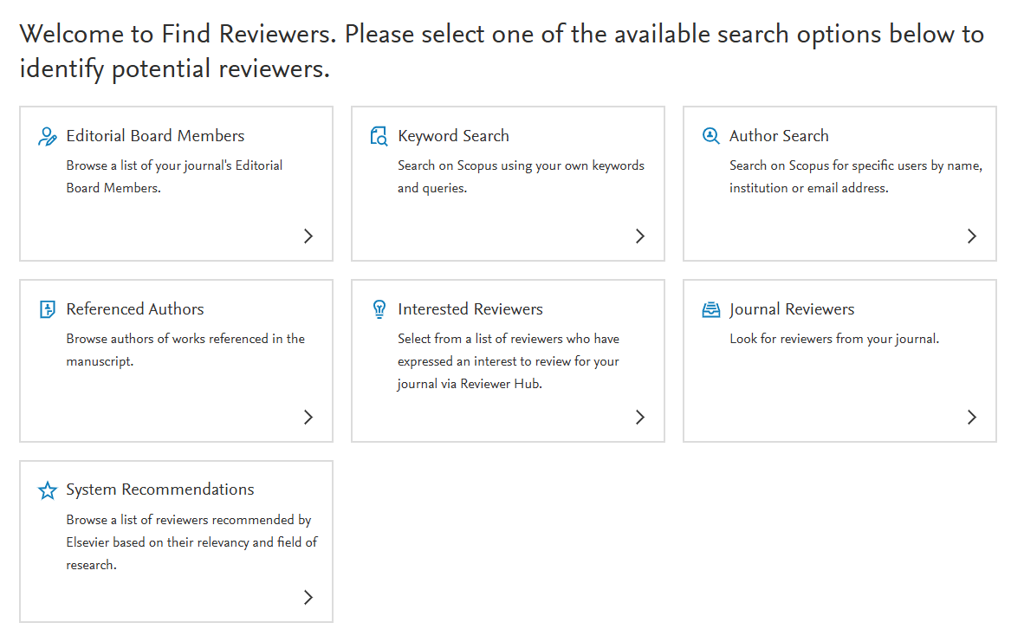
Literature Review
What papers should you cite?
Recent studies, classic papers
Target journals, top journals, potential reviewers
…
Notes:
Google search titles

Slide 14
Literature Review
What papers should you cite?
Recent studies, classic papers
Target journals, top journals, potential reviewers
…
Critique (vs. narrative)
It is highly recommended; to show your understanding
Highlight others’ contribution and weaknesses (gaps)
Theme

Slide 15
Conclusions
KEY results: echo research questions in Introduction and gaps in Literature Review
Policy implications
Based on results but beyond the results
Limitations
Limitations + results vs. results + limitations
Limitations vs. recommendations

Slide 16
Framing and Writing
Backward writing
The first sentence is always the main point of the paragraph.
What is a good logic?
Between paragraphs
Within paragraphs

Slide 17
Plagiarism - by Pat Mokhtarian
“Plagiarism is the use of other people’s words or ideas without giving them appropriate credit.
This commonly happens in one of two ways:
You present an idea that you obtained from another source, without citing that source.
You cite the source for your idea, but you use the source’s exact words without enclosing them in quotation marks.”
https://www.ieee.org/publications/rights/plagiarism/id-plagiarism.html
“However, there are in fact degrees of plagiarism: one can steal an entire paper, or a section of a paper, or a page, a paragraph or a sentence. Even copying phrases without credit and quotation marks can be considered plagiarism. In other words, paraphrasing done improperly can qualify as plagiarism.”
Notes:
http://www.nytimes.com/1984/05/19/nyregion/rutgers-professor-resigning-after-plagiarism-accusation.html
http://www.thecrimson.com/article/1988/11/29/med-school-professor-resigns-after-admitting/
http://chronicle.com/article/Professor-Whose-Article-Was/42521
http://www.dailybruin.com/index.php/article/2009/05/ucla-professor-plagiarizes

Slide 18
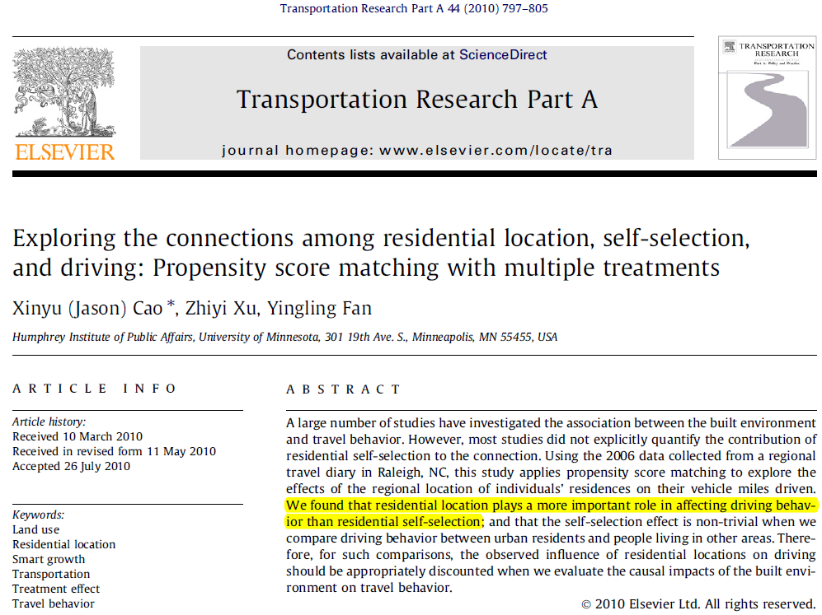

Slide 19
Citation Examples – Concerns?
… Residential location plays a more important role in affecting driving behavior than residential self-selection. …
… Cao et al. (2010) concluded that residential location plays a more important role in affecting driving behavior than residential self-selection. …
… Cao et al. (2010) concluded that “residential location plays a more important role in affecting driving behavior than residential self-selection”. …
… Cao et al. (2010) concluded that residential self-selection plays a less important role in affecting driving behavior than residential location. …
… Cao et al. (2010) concluded that the impact of residential location on driving behavior exceeds that of residential self-selection. …
Notes:
With citation
With quotation
Without page number
Revising a few words
fine

Slide 20
A few tips
Read and cite recent and relevant papers published in the journal you intend to submit your paper.
Highlight your unique contribution.
Use simple words to write simple sentences.
Editorial services: Do not irritate/frustrate reviewers with poor English.

